Slide 1
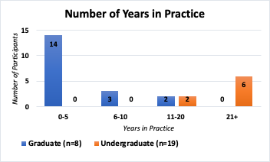
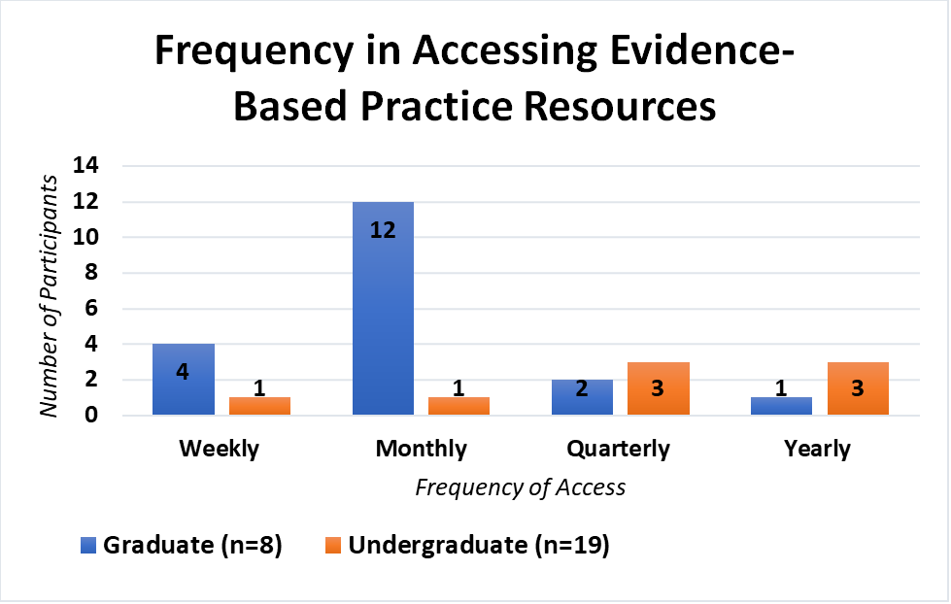
The Use of Evidence-based Practice Resources Among Occupational Therapists Working with Adults with a Traumatic Brain Injury
Alissa Cannoy, OTD, OTR/L, CBIS, Jared Buckingham, B.A., S/OT, Hope Jones, B.S., S/OT, and Alexis Putnam, B.I.S., S/OT
Master of Occupational Therapy Program - Shawnee State University
♦ Abstract
♦ Research Questions
♦ Discussion
This retrospective cross-sectional analysis of descriptive survey data (n=27) from a previous study examined common practice patterns among occupational therapists working with adults with a traumatic brain injury in post-acute rehabilitation settings. Descriptive statistics illustrated practice patterns, and Chi-square analysis examined relationships between level of education, years in practice, and implementation of evidence-based practice resources. Statistically significant relationships were noted between practitioner level of education and number of years in practice (p=0.000059), and level of education and frequency of accessing evidence-based practice resources (p=0.024). In this sample, level of education and number of years in practice influenced evidence-based practice patterns.
Does level of education impact the utilization of evidence-based practice resources for occupational therapists working in a post-acute rehabilitation setting for adults with traumatic brain injury?
Do the number of years in practice impact the utilization of evidence-based practice
resources for occupational therapists working in a post-acute rehabilitation setting for adults with traumatic brain injury?
Occupational therapists with graduate-level degrees were more likely to report a lower number of years in practice than practitioners with undergraduate degrees who reported a higher number of years in practice.
Practitioners with a graduate degree reported accessing evidence significantly more often than practitioners with an undergraduate degree.
No significant relationship between practitioner level of education and types of evidence-based practice resources implemented, how evidence-based practice resources were accessed, and barriers to accessing evidence-based practice resources were noted. This indicated similar EBP skills in both levels of education.
Without the support of the practitioner’s organization, improvements toward the access and implementation of evidence-based practice resources may continue to be limited (Fernandes, 2022).
Limitations included nonresponse bias as participants elected to not respond or participate fully and response bias as researchers were unable to discern how some participants understood and responded to some survey questions (Taylor, 2017). Researchers were unable to determine if the participants selected their entry level of education required to practice in their state or their post-professional level of education.
Future research is warranted on daily evidence-based practice patterns of practitioners and how barriers could be minimized to enable the use of evidence-based resources.
One clinical implication is that practitioners with a higher level of education tend to access evidence-based practice resources more often. Also, implementation of evidence-based practice resources should be a thoroughly defined expectation for all practitioners. Barriers should be investigated and minimized collaboratively between practitioners and administrators.
♦Methods
Effects of traumatic brain injury (TBI) impact an adult’s ability to engage in meaningful occupations, which are the meaningful or necessary activities that occupy a person’s time throughout the day (AOTA, 2020).
Occupational therapy (OT) assist adults with traumatic brain injury by helping them achieve optimal health, well-being, and participation in meaningful occupations through participating in client-centered occupations (AOTA, 2020; Wheeler & Acord-Vira, 2016).
OT is an essential form of rehabilitation for treating individuals with traumatic brain injuries in the post-acute rehabilitation setting (Wheeler & Acord-Vira, 2016).
Use of evidence-based practice (EBP) resources is a core principle of occupational therapy practice and maximizes quality outcomes (Alter & Stephens, 2020; AOTA, 2020).
Data was collected from a previous research study led by Cannoy (2021) that examined practitioner use of evidence-based practice resources, theory, assessments, interventions, and outcome measures for adults with a traumatic brain injury in post-acute rehabilitation settings.
♦ Introduction
Retrospective cross-sectional analysis of data from the Cannoy (2021) study that examined common practice patterns of occupational therapists working with adults with traumatic brain injury in post-acute rehabilitation settings.
Cannoy (2021) used snowball sampling to gather participants for the online survey.
IRB approval and informed consent were obtained from the Cannoy (2021) study and are applicable to this study.
Data cleaning process to eliminate participants that provided responses inconsistent with this study's inclusion criteria.
Standard data coding strategy to translate participant responses into numerical values with a triangulation, cross-checking strategy to assure accurate coding between researchers.
Examined descriptive statistics of respondents through visual inspection and Chi-square analysis on selected questions from the Cannoy (2021) study.
Inclusion criteria:
Occupational therapists with an active license in their state of practice
Entry level education of either a graduate or undergraduate degree.
Provided occupational therapy services to adults with traumatic brain injury in a post-acute rehabilitation setting.
Provided informed consent and fully completed the 28-question survey.
♦Results
♦ Purpose
♦ Conclusion
The purpose of this study was to examine factors that influence the implementation of evidence-based practice resources by occupational therapists who work with adults with a traumatic brain injury in a post-acute rehabilitation setting.
Inconsistencies exist in the utilization and implementation of evidence-based practice resources by occupational therapists who work with adults with a traumatic brain injury in a post-acute rehabilitation setting.
Graduate-level practitioners more frequently access evidence-based practice resources as compared to undergraduate-level practitioners.
Despite inconsistencies and barriers, post-acute occupational therapy rehabilitation for adults with traumatic brain injury is necessary and valuable to minimize disability, and increase independence, quality of life, and well-being.
Occupational therapists working with adults with traumatic brain injury should consider AOTA’s Occupational Therapy Practice Guidelines for Adults with Traumatic Brain Injury (Wheeler & Acord-Vira, 2016) (PG-TBI) to support their practice as this is an evidence-based practice resource developed for practitioners.
♦ References
American Occupational Therapy Association. (2020). Occupational therapy practice framework: Domain and process (4th ed.). American Journal of Occupational Therapy, 74(Suppl. 2), 741241001. https://doi.org/10.5014/ajot.2020.74S2001
Atler, K., & Stephens, J. (2020). Pilot use of the adapted fresno test for evaluating evidence-based practice knowledge in occupational therapy students. American Journal of Occupational Therapy, 74(4), 7404205100p1–7404205100p9. https://doi.org/10.5014/ajot.2020.037861
Cannoy, A. (2021). Factors contributing to the use of evidence-based resources for occupational therapists working in post-acute brain injury rehabilitation [Unpublished Doctoral Dissertation]. Shawnee State University.
Fernandes, A. (2022). Moving toward evidence-based practice: A research utilization capacity building program, [Doctoral dissertation, Boston University]. Boston University Libraries. https://hdl.handle.net/2144/45080
Taylor, R. R. (2017). Kielhofner's research in occupational therapy: Methods of inquiry for enhancing practice. F. A. Davis Company.
Wheeler, S. & Acord-Vira, A. (2016). Occupational Therapy Practice Guidelines for Adults With Traumatic Brain Injury. AOTA Press.
Statistically significant relationship, χ2(3, N=27) = 22.20, p=0.000059, between practitioner level of education and number of years in practice.
Statistically significant relationship, χ²(3, N=27) = 9.38, p=0.024, between level of education and frequency in accessing evidence-based practice resources.

