Slide 1
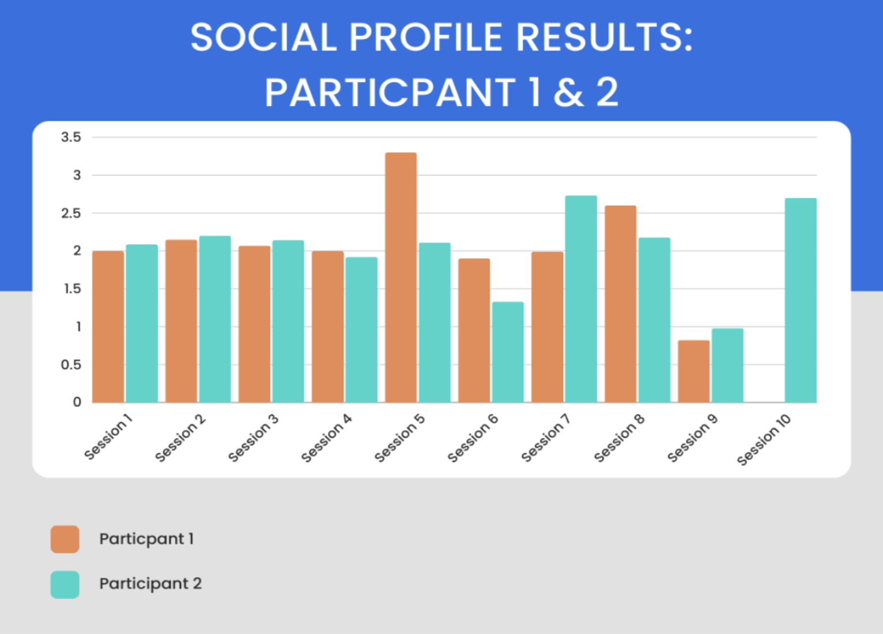
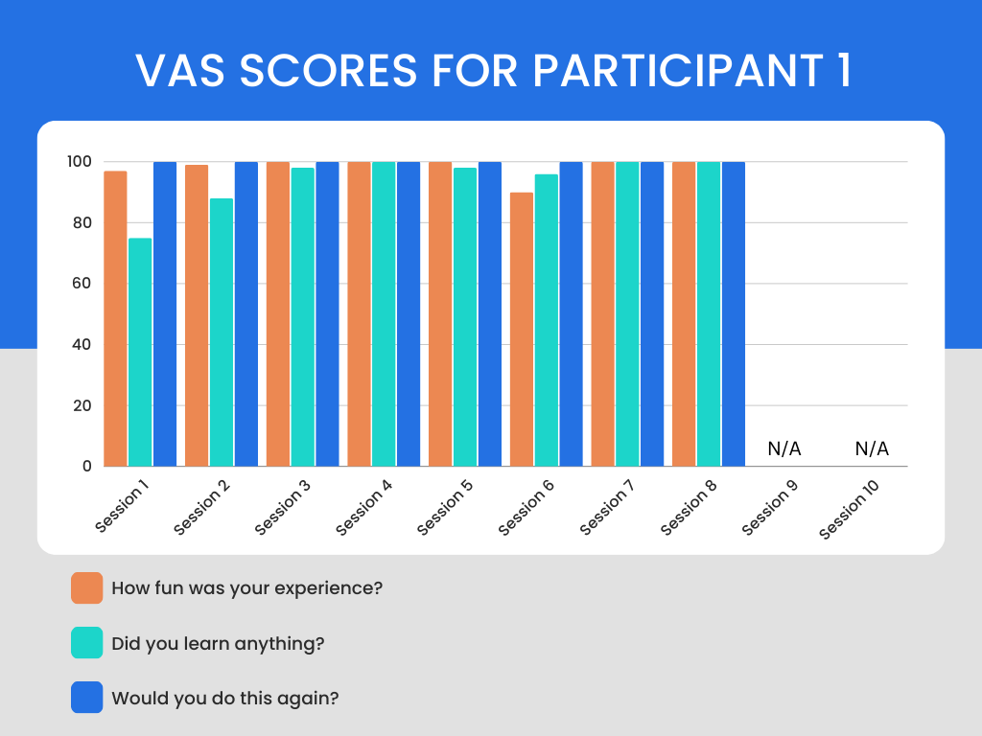
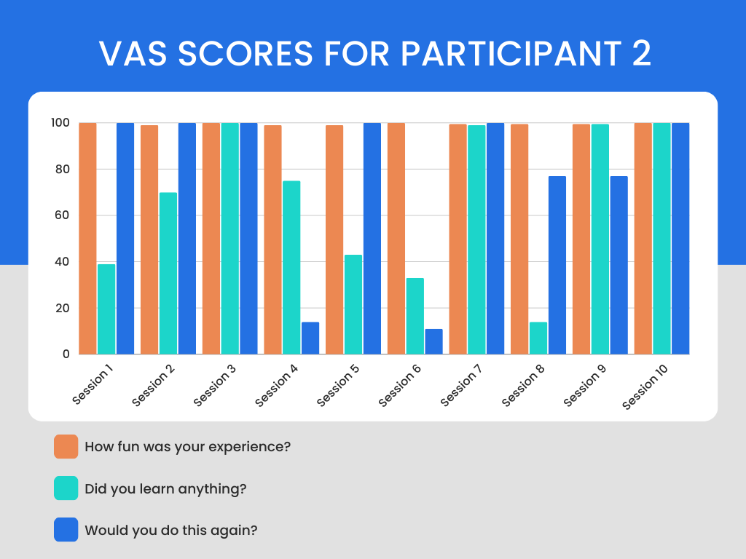
Effects of Occupation-Based Services on the Occupational Functioning of Youth in the Alternative School Environment
Mikel Stone, OTD, OTR/L, Brianna Odel, B.S., S/OT, Madylyn Stegbauer B.S., Gina Van Lieu, B.S., S/OT, and Kayleah Wright, B.A., S/OT
Research Question
Literature Review
Discussion
What impact do occupation-based interventions have on the occupational functioning of leisure for at-risk adolescents in the alternative school setting as measured by the Social Profile Assessment and pre-post Visual Analog Scale?
Leisure and At-Risk Youth
Increase in pro-social activities has shown to have a decrease on at-risk behaviors in adolescence (Mahoney & Stattin, 2000; Jussila et al., 2022).
Adolescent At-Risk Behaviors
Center for Disease Control and Prevention (CDC) provided a ten-year summary of at-risk behaviors among youth from 2011-2021 through the YRBS (CDC, 2023).
Substance Use
In the U.S. in 2021, among individuals aged 12+, approximately 46.3 million met the DSM-5 criteria for having a substance use disorder (SUD) (SAMHSA, 2023).
Risky Sexual Behaviors
In 2019, 27.4% of youth were sexually active, and of this percent, 11.9% of these individuals did not use any method to prevent pregnancy during last sexual intercourse (CDC, 2021).
Experience with Violence
In 2019, 21.9% of adolescents had been in a physical fight within the previous 12 months (CDC, 2021.).
Mental Health/Suicidality
In 2019, 36.7% of adolescents felt sad or hopeless every day for 2 or more weeks in a row, to the point that they stopped doing their usual activities, and 8.9% attempted suicide (CDC, 2021).
Findings
Occupation-based leisure interventions were highly successful in providing ideas for fun activities that the participants could learn/would be willing to do again.
Influence scores for the participants showed there was a favorable outcome from the occupation-based leisure interventions.
Occupation-based leisure interventions did not have a direct effect on social participation scores.
Strengths
Positive group interactions and rapport building created a positive environment.
Interventions administered increased awareness of pro-social leisure.
Person-Environment-Occupation (PEO) model utilized to better understand students (person) and how they interact with leisure activities (occupation) within their environment.
Limitations
Small sample size
Limited diversity of participants
Levels of the Social Profile and how each activity aligned with the various social levels
Future Research
Utilization of social skill training in student researchers to increase social skills strategies with students.
Determine the impact of occupation-based leisure interventions on students who fall in the parallel, supportive cooperative, and mature levels.
Exploring different themes based on maturity levels rather than negative behaviors.
Introduction
Occupational dysfunction in the area of leisure can be detrimental to adolescents, as it has a major influence on how they spend their time. Therefore, it is imperative that research is done to measure the effects of prosocial leisure among at-risk adolescents. Pursuing research involving this population will contribute to the available evidence and allow practitioners to engage in evidence-based practice.
Methods
Purpose/Problem
The study participants included 2 students in an alternative school setting. Leisure activity interventions were performed each session. The Social Profile: Adult/Adolescent Version (SP) was used to assess individual functioning and social participation during activities (Donohue, 2013). It ranked the participants social interaction into one of five categories; 1 being parallel, 2 being associative, 3 being basic cooperative, 4 being supportive cooperative and 5 being mature. A Visual Analog Scale (VAS), administered before and after each session, was used to assess knowledge pertaining to leisure activities by each participant (Hayes & Patterson, 1921). The VAS measured if the participant had done the activity before by yes or no, how much fun they had, how much they learned, and if they would do it again being rated from 0-100. A thematic analysis was done to identify, analyze, and report patterns within the SP fieldnotes after each session (Braun & Clark, 2006). Data was collected over 10 sessions. IRB approval was received May 4, 2022.
Problem: At-risk youth are often not engaging in prosocial leisure, which can lead to participation in negative behaviors (Mahoney & Stattin, 2000). At-risk youth need exposure to healthy leisure activities to minimize the engagement in risky behaviors.
Purpose: The purpose of the study was to evaluate the impact that occupation-based leisure interventions had on at-risk adolescents in the alternative school setting.
Results
Conclusion
The study concluded that out of the five total participants in the study, only two met the full criteria for data collection within the study. Based on the results of the Visual Analog Scale (VAS), both participants recorded having high levels of fun, increased learning, and higher probability of participating in the future with the given leisure activities. The results of the Social Profile determined that both participants were at the level of associative to basic cooperative functioning across all sessions. This indicated that both participants may have met the threshold for the social requirements afforded of the given activities. Two themes were predicted to be factors in the participant's performance, contribution to the group/activity, and detraction from the group/activity.
The results indicate that occupation-based leisure interventions play an effective role in supporting prosocial leisure among at-risk youth. Gaining information on youth social participation levels is also effective in creating leisure activities appropriate for the population.
References
Braun, V., & Clarke, V. (2006). Using thematic analysis in psychology. Qualitative Research in Psychology, 3(2), 77– 101. https://doi.org/10.1191/1478088706qp063oa
CDC. (2021.) High school YRBS: United States 2019 Results. CDC. https://nccd.cdc.gov/youthonline/App/Results.aspxOUT=0&SID=HS&QID=QQ&LID=XX&YID=2021&LID2=&COL=S&ROW1=N&ROW2=N&FR=R1&FG=G1&F A=A1&FSL=S1&FGL=G1&PV=&TST=False&C1=&C2=&QP=G&SYID=&PF=1
CDC. (2023). YRBSS data summary & trends. CDC. https://www.cdc.gov/healthyyouth/data/yrbs/yrbs_data_summary_and_trends.html
Donohue, M. V. (2013). Social Profile: Assessment of social participation in children, adolescents and adults. AOTA
Hayes M. H. S., & Patterson D. G. (1921). Experimental development of the graphic rating method. Psychol. Bull. 18, 98–99.
Jussila, J. J., Pulakka, A., Ervasti, J., Halonen, J. I., Mikkonen, S., Allaouat, S., Salo, P., & Lanki, T. (2022). Associations of leisure‐time physical activity and active school transport with mental health outcomes: A population‐based study. Scandinavian Journal of Medicine & Science in Sports, 33(5), 670–681. https://doi.org/10.1111/sms.14292
Mahoney, J., & Stattin, H. (2000). Leisure activities and adolescent antisocial behavior: The role of structure and social context, Journal of Adolescence, 23(2) 113-127 https://doi.org/10.1006/jado.2000.0302
Substance Abuse and Mental Health Services Administration (SAMHSA). (2023). Samhsa announces National Survey on Drug Use and Health (NSDUH) results detailing mental illness and substance use levels in 2021. U.S. Department of Health and Human Services. https://www.hhs.gov/about/news/2023/01/04/samhsa-announces-national-survey-drug-use-health-results-detailing-mental-illness-substance-use-levels-2021.html#:~:text=46.3%20million%20people%20aged%2012,having%20a%20drug%20use%20disorder
♦ ♦ ♦ ♦ ♦ ♦ ♦ ♦ ♦ ♦ ♦ ♦ ♦ ♦ ♦ ♦ ♦ ♦ ♦ ♦ ♦ ♦ ♦ ♦ ♦ ♦ ♦ ♦ ♦ ♦ ♦ ♦ ♦ ♦ ♦ ♦ ♦ ♦ ♦ ♦ ♦ ♦ ♦ ♦ ♦

