Slide 1
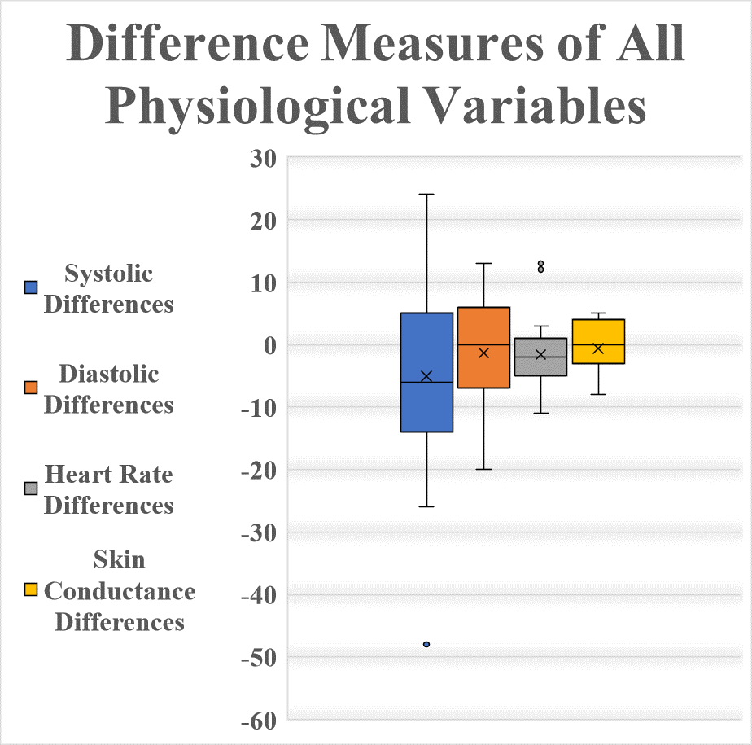
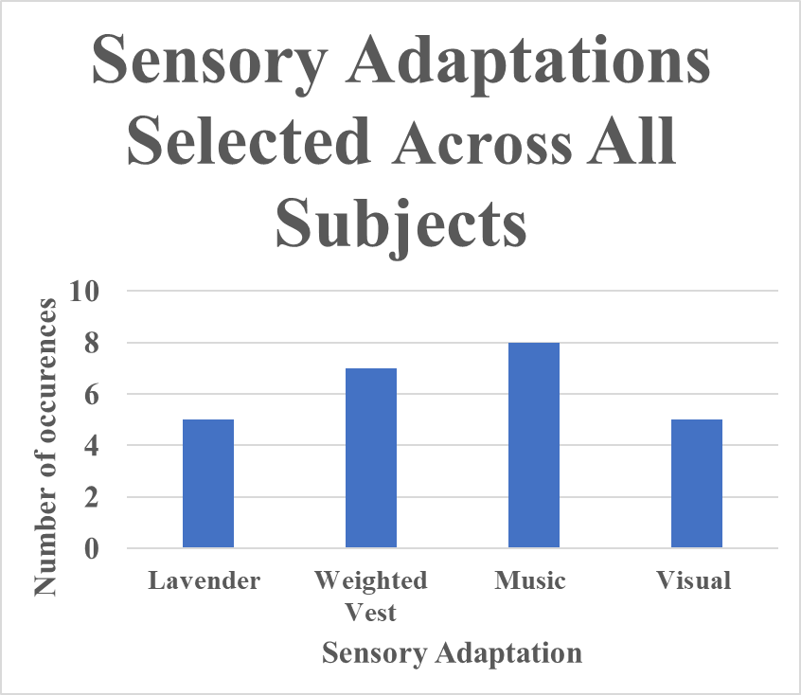
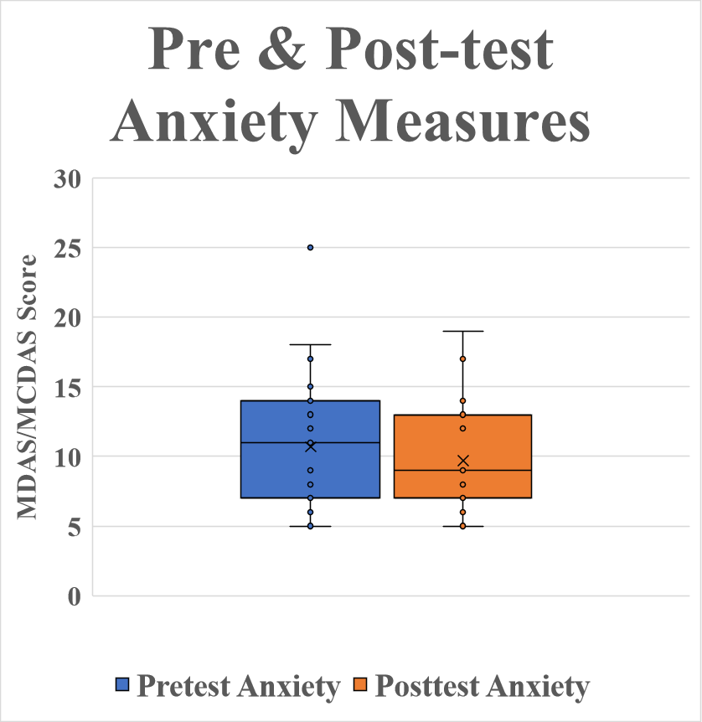
Using a Sensory Adapted Dental Environment to Determine a Change in Dental Anxiety for Neurotypical Individuals
Barbara Warnock DHSc, OTR/L, Zayden Rinehart S/OT, Audrey Jenkins S/OT, Alexis Tompkins S/OT, Cassidy Shumate S/OT.
Shawnee State University
♦ Abstract
♦ Discussion
Background: This research aims to further and support current research on sensory adapted dental environments (SADE) during routine dental procedures on neurotypicals individuals.
Methods: A quasi-experimental pretest-posttest design was utilized to collect data from 23 subjects at a dental clinic in southern Ohio. Four sensory adaptation (SA) options were provided. Dependent variables were heart rate, blood pressure, skin conductance, and anxiety. Statistical analysis and data were computed at a significant p-value of .05 using Microsoft Excel, GPower, and WebPower.
Results: Decrease in anxiety was found to be statistically significant (p<.05) in the sample with the use of any SA. Music was the most preferred SA chosen by subjects (n=8).
Conclusion: The findings suggest that SADE significantly decreased anxiety across all ages (10-82) with varying SA’s.
♦ Research Questions
♦ Purpose
The current study found the highest pre-test anxiety from a self-report anxiety measure in ages 8-18. The freedom of choice given to participants to select sensory adaptations may have created a cognitive awareness/perception of change but did not present measurable physiological changes.
Limitations:
Small sample size (N=23)
Limited data collection time (12 weeks)
Decreased recruitment numbers (no answer or call back during phone calls)
Low external validity towards larger population
Strengths:
The measurement of both psychological and physiological responses
Data collection for a neurotypical population making results more generalizable to a larger population
Study includes neurotypical population which has limited research
Future Research: Future research is needed to further evaluate the relationship between dental anxiety and sensory adaptations during complex dental procedures (root canals, extractions, braces, etc.). Future studies should examine neurotypical individuals as majority of research focuses on neurodivergent individuals' dental anxiety and sensory adaptations.
Does change in anxiety scores occur, as measured by the Modified Dental Anxiety Scale or Modified Child Dental Anxiety Scale, in subjects with the use of a SA?
What is the most preferred SA amongst the participants?
What are the differences in levels of dental anxiety in relation to participant age?
What effect do SA's have on physiological scales (HR, BP, skin conductance)?
The purpose of this study was to examine the effects of a sensory adapted dental environment during routine dental cleaning appointments. This study examined anxiety levels through self-report assessment (MCDAS and MDAS) , heart rate, skin conductance, and blood pressure.
.
♦ Methods
Received IRB approval September 2023
Inclusion Criteria: Age 8+, routine dental cleaning, patient of southern Ohio dental clinic for routine dental cleaning
Exclusion Criteria: Individuals taking anti-anxiety medication, autism spectrum disorder, or anyone who could not verbally consent
Quasi-experimental pre-post test design was utilized
Independent variables: Weighted vest, visual projection, lavender, music
Dependent variables: HR, BP (systolic/diastolic), skin conductance, anxiety measure (MDAS/MCDAS)
Consent and assent forms were completed digitally during recruitment calls
Gatekeeper of dental facility stored forms digitally on office software
Statistical analysis was conducted using Excel, WebPower, and GPower
Significance level of p<.05 was established
♦ Introduction
Dental anxiety is “a feeling of nervousness or apprehension that is associated with dental treatment and can range from mild discomfort to a more severe form that can interfere with treatment and cause significant distress to the patient” (Alansaari et al., 2023, p. 2). Detectable signs of anxiousness include sweating, increased heart rate, and increased blood pressure.
Occupational therapists examine anxiety holistically, looking at both environmental and internal sensations that could reach a neurological threshold and cause a physiological response (Parham & Mailoux, 2020). According to the Person-Environment-Occupational Model, an environment could impact an individual's behavior during the occupation of oral care (Law, 1996).
A sensory adapted dental environment has shown potential to reduce dental related anxiety, behavioral stress, pain, psychological stress, and sensory discomfort according to a study conducted by Cermak (2015). A SADE is an environment that has been changed to relax one's senses within a given environment.
♦ Results
♦ Conclusion
Findings suggest that SADE significantly decreased anxiety across all ages 10-82. Statistically significant data was found in pre-post-test MDAS/MCDAS scores. No statistical significance was linked to SADE implementation and physiological responses.
♦ References
Alansaari, A. B. O., Tawfik, A., Jaber, M. A., Khamis, A. H., & Elameen, E. M. (2023).
Prevalence and socio-demographic correlates of dental anxiety among a group of adult patients attending dental outpatient clinics: A study from UAE. International Journal of Environmental Research and Public Health, 2012). https://doi-org.proxy01.shawnee.edu/10.3390/ijerph20126118
Cermak, A. S., Stein Duker, I. L.,Williams, E. M., Lane, J. C., Dawson, E. M., Borreson, E. A., & Polido, C. J. (2015). Feasibility of a sensory-adapted dental environment for children with autism. American Journal of Occupational Therapy, 69(3), 1-10. https://doi.org /10.5014/ajot.2015.013714
Law, M. (1996). The Person-Environment-Occupation Model: A Transactive Approach to
Occupational Performance. Canadian Journal of Occupational Therapy, 63(1), 9-23.
Parham, L. D., & Mailloux, Z. (2020). Sensory integration. In J. C. O’Brien & H. Kuhaneck (Eds.) Case-Smith’s Occupational therapy for Children and Adolescents (8th ed., pp. 516- 542). Elsevier.
Statistically significant, t(22) = -2.3, p=.032, changes in mean differences between pre-posttest anxiety measures.
Physiological pre-post measures were not statistically significant
♦ ♦ ♦ ♦ ♦ ♦ ♦ ♦ ♦ ♦ ♦ ♦ ♦ ♦ ♦ ♦ ♦ ♦ ♦ ♦ ♦ ♦ ♦ ♦ ♦ ♦ ♦ ♦ ♦ ♦ ♦ ♦ ♦ ♦ ♦ ♦ ♦ ♦ ♦ ♦ ♦ ♦ ♦ ♦ ♦

